Slide 1
MODULE 3

Slide 2
Module III
Array processors - SIMD array processors – Interconnection networks - Static vs dynamic networks - mesh connected networks - Cube interconnection networks - Parallel algorithms for array processors - SIMD matrix multiplication-Parallel sorting on array processors - Associative array processing - Memory organization.

Slide 3
SIMD array processors
Key Characteristics:
Synchronous array of parallel processors is called array processors
Consists of multiple processing elements (PEs) under the supervision of single control unit (CU)
Array processor can handle single instruction and multiple data (SIMD) streams
Especially designed to perform vector computations over matrices or array of data

Slide 4
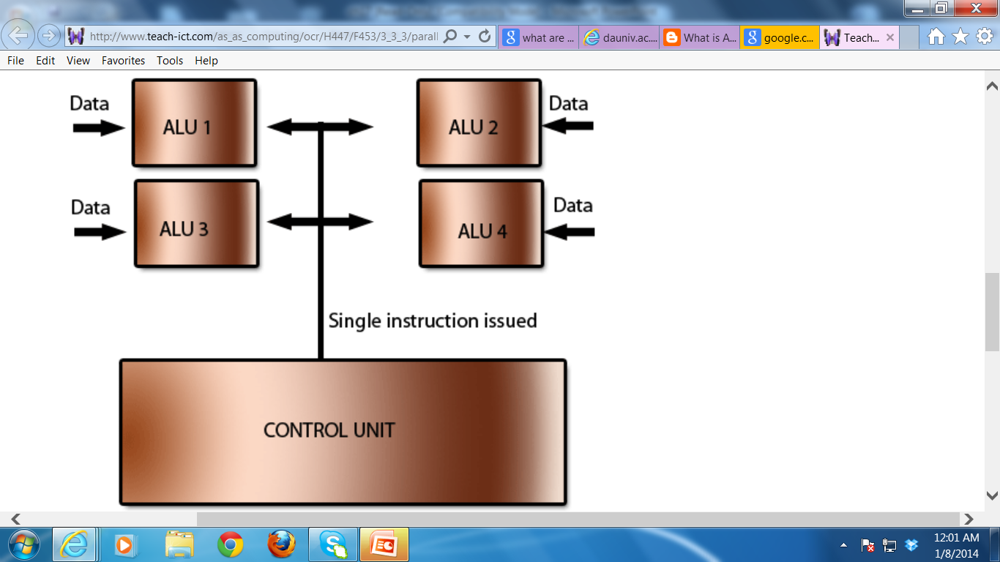
With an array processor, a single instruction is issued by a control unit and that instruction is applied to a number of data sets at the same time.
An array processor (or vector processor) has a number of Arithmetic Logic Units (ALU) that allows all the elements of an array to be processed at the same time.

Slide 5
Architectural configurations
Array processors, using random access memory
Associative processors, using content addressable memory

Slide 6
SIMD Computer Organizations
Common Features:-
Number of synchronized processing elements(PEs)
Controlled by single control unit (CU)
CU has its own memory for storing control instructions
Control unit directly supervises execution of instructions
Masking schemes are used to activate or deactivate processing elements (PEs)
At each instruction cycle, some PEs are active and some are inactive
Processor is connected to a host computer through CU
Host computer performs resource management, I/O supervision, etc.

Slide 7
SIMD Computer Organizations
Two configurations:
Configuration 1 implemented in Illiac –IV
Configuration 2 implemented in BSP(Burroughs Scientific computer)

Slide 8

SIMD Computer Organizations contd.
Case Study: Illiac IV
I/O
Data & Instruction
Data Bus
CU
Memory
CU
Control Bus
PE₀
PE₁
PE_{n-1}
PEM₀
PEM₁
PEM_{n-1}
Interconnection Network

Slide 9
Configuration is structured with N synchronized PEs, under the control of one CU.
PEi is an ALU with attached working registers and local memory PEMi, for storage of distributed data.
CU has its main memory for the storage of programs. The system/user programs are executed under the control of CU.

Slide 10
User programs are loaded into the CU memory from an external source.
Function of CU is to decode instructions and determine where the decoded instructions should be executed.

Slide 11
Scalar/control type instructions are executed inside the CU.
Vector instructions are broadcast to the PEs for distributed execution to achieve spatial parallelism through duplicate arithmetic units (PEs).
All PEs perform same function synchronously in a lock-step fashion under the CU.

Slide 12
Vector operands are distributed to the PEMs before the parallel execution in the array of PEs.
Distributed data can be loaded into the PEMs from an external source via the system data bus/ via CU in a broadcast mode using the control bus

Slide 13
PEs may be either active or disabled during an instruction cycle.
Masking vector is used to control the status of PEs during the execution of a vector instruction. Only enabled PEs participate in the execution of a vector instruction.

Slide 14
Data exchanges among PEs are done via an inter PE communication network (under the control of the control unit), which performs all data routing and manipulation functions

Slide 15
An array processor is interfaced to a host computer through the control unit.
Host computer is a general-purpose machine which serves as “operating manager” of the entire system (consisting of the host and the processor array). Functions of the host computer include resource management and peripheral-I/O supervisions

Slide 16
CU of the processor array supervises the execution of programs whereas host machine performs the executive and I/O functions with outside world.
In this sense, array processor can be considered a back end, attached computer, similar in function to pipeline attached processors

Slide 17
SIMD Computer Organizations contd.
Case Study: Burroughs Scientific Processors (BSP)
I/O
Data & Instruction
Data Bus
CU
Memory
CU
Control Bus
PE₀
PE₁
PE_{n-1}
Inter PE Memory Alignment Network
M₀
M₁
M_{p-1}

Slide 18
Difference between the configurations --in two aspects
I - local memories attached to the PEs are replaced by parallel memory modules shared by all PEs through an alignment network.
II - inter PE permutation network is replaced by the inter PE memory alignment network which is again controlled by CU.
Eg: Burroughs scientific processor (BSP).

Slide 19
There are N PEs and P memory modules.
----2 numbers are not necessarily equal. They have been chosen to be relatively prime.
The alignment network is path-switching network between PEs and parallel memories.
------To allow conflict free accesses of the shared memories by as many PEs as possible.

Slide 20
SIMD representation
SIMD computer can be represented as:-
C = < N, F, I, M >
where
N:number of PEs in system
F: set of data routing functions provided by interconnection network or alignment network
I: set of machine instructions for scalar-vector, data routing and network manipulation operations
M: set of masking schemes, where each mask set divides PEs into two subsets of enabled and disabled PEs

Slide 21
Masking & Data routing
Each PE (Configuration 1) consist of following:-
Memory, PEM_{i}
Set of working registers, A_{i}, B_{i}, C_{i}
Performs arithmetic operations
Status Flag (enable/disable), S_{i}
Used in masking, decides whether PE is active or inactive
Local index register, I_{i}
Address register, D_{i}
Location of address in PEM_{i}
Data routing register, R_{i}
R_{i} is connected to R_{j} of another PE_{i}

Slide 22
PE Components
CU
Global registers:
index register & masking register
A_{i}
B_{i}
C_{i}
To other
PEs via
Inter-
connection
Network
PE_{i}
D_{i}
I_{i}
R_{i}
S_{i}
ALU
PEM_{i}

Slide 23
Here each PE is a processor with its own memory PEM; a set of working registers and flags , namely A, B, C and S; an ALU; a local index register I; an address register D and a data routing register R.
The R of each PE is connected to the R of other PE via the interconnection n/w.
When data transfer among PEs occur contents of R registers are being transferred

Slide 24
The D is used to hold the m-bit address of the PE.
Some array processors use 2 routing registers - for i/p and o/p.
PE is either in active or inactive mode during instruction cycle.
If a PE is active, it executes the instruction broadcast to it by the CU otherwise it will not.
Masking schemes are used to specify the status flag S of PE.
S=1 indicate active PE and 0 for inactive PE

Slide 25
In CU there is a global index register I and a masking register M. The M register has N bits. The ith bit of M is denoted as Mi.
The collection of Si flags for i=0,1,2,---N-1 forms a status register S for all the PEs.
Bit patterns in registers M and S are exchangeable upon the control of CU when masking is to be set

Slide 26
Inter-PE communications
Network design is the fundamental decision in determining appropriate architecture of an interconnection network for an SIMD machine

Slide 27
Factors affecting Inter-PE design
Operating Mode
Synchronous or Asynchronous or Combined
Control Strategy
Centralized or Distributed
Switching methodology
Circuit or Packet switching
Network Topology
Graph:
nodes --> switching points & edges --> communication links
Type of topology: Linear array, ring, star, tree,
Static or Dynamic

Slide 28
Operation mode:
2 types of communication: synchronous and asynchronous.
Synchronous communication needed for establishing communication paths synchronously for either data manipulating function or for data instruction broadcast.
Asynchronous communication is needed for multiprocessing in which connection requests are issued dynamically

Slide 29
Control strategy: A typical interconnection n/w consists of a no. of switching elements and interconnecting links.
Interconnection functions are realized by properly setting control of the switching elements.

Slide 30
Switching methodology:
---- circuit switching and packet switching.
circuit switching: physical path is established between source and destination.
packet switching: data is put in a packet and routed through the interconnection n/w without establishing a physical connection path.

Slide 31
N/w topology:
N/w is depicted by a graph.
nodes represent switching points and edges represent communication links.
Topologies grouped into 2 categories:
static and dynamic. Static topology: links between 2 processors are passive and dedicated buses cannot be reconfigured for direct connections to other processors.
Links in the dynamic category can be reconfigured by setting the n/ws active switching elements.

Slide 32
SIMD interconnection n/ws
SIMD interconnection n/ws are classified based on n/w topologies: static n/ws and dynamic n/ws.

Slide 33
Static n/ws
Topologies in the static n/ws can be classified according to the dimensions (1D, 2D, 3D and hypercube) required for layout.

Slide 34
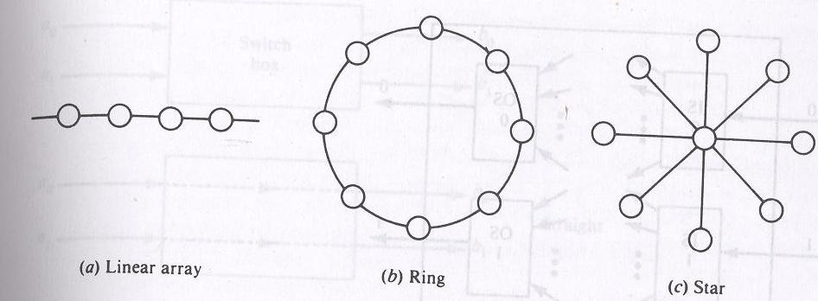

Slide 35
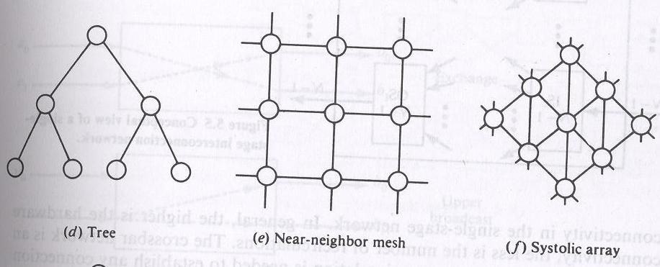

Slide 36
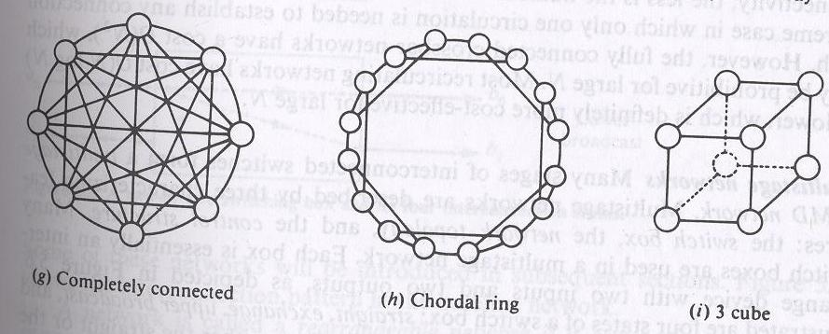

Slide 37
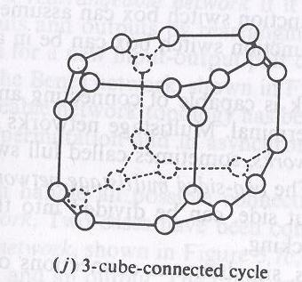

Slide 38
Eg of 1D : linear array
2D: ring, star, tree, mesh, and systolic array.
3D:completely connected, chordal ring, 3 cube, 3 cube connected cycle.
A D dimensional W-wide hypercube contains W nodes in each dimension and there is a connection to a node in each dimension.
Mesh and 3 cube are actually 2 and 3D hypercubes

Slide 39
Dynamic networks can be classified according to the routing functions
Single stage
Multi stage

Slide 40
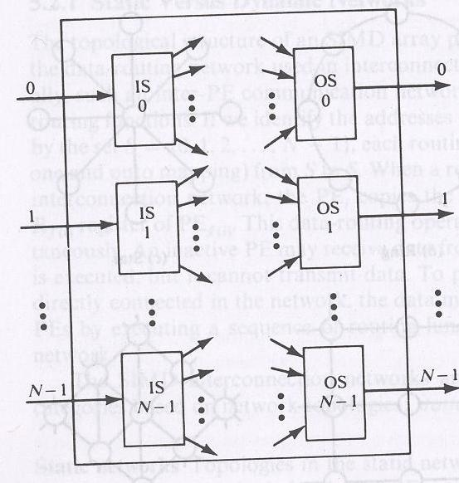
Single stage networks

Slide 41
IS is a 1 to D demultiplexer and OS is an M to1 multiplexer where 1<=D<=N and 1<=M<=N.
Crossbar switching n/w is a single stage n/w with D=M=N(full connectivity)
To establish a connecting path, different path control signals will be applied to all IS and OS.

Slide 42
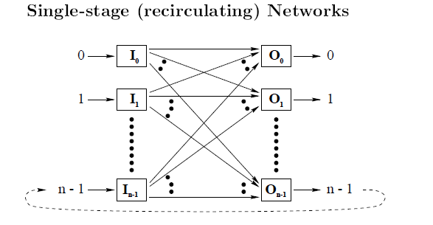

Slide 43
If the network does not have full connectivity , several passes through the network is needed to perform routing to a destination OS, hence recirculating.
The greater the connectivity less recirculating required.

Slide 44
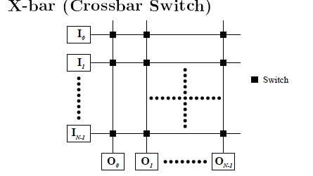

Slide 45
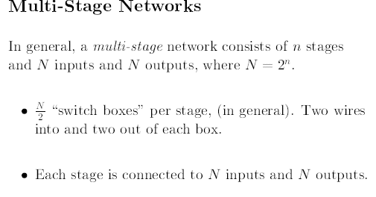

Slide 46
Multistage n/ws are described by 3 characterizing features:
switch box
network topology
control structure.

Slide 47
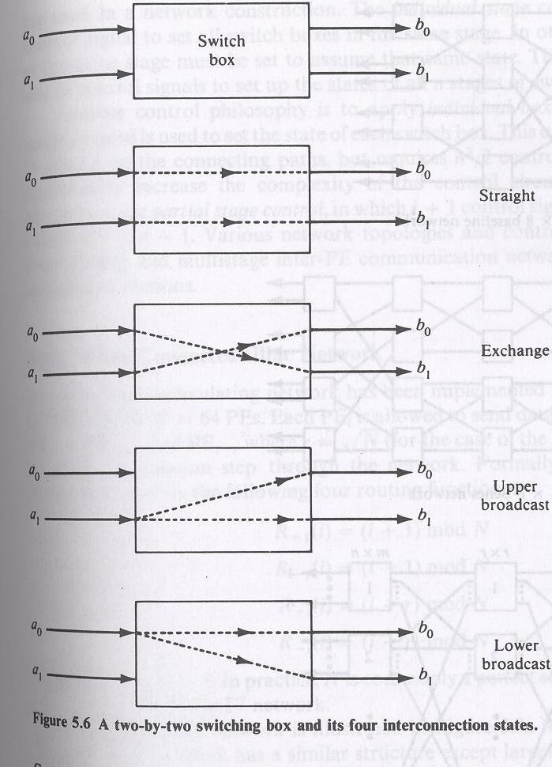

Slide 48
Many switch boxes are used in a multistage n/w.
Each box is an interchange device with 2 i/ps and 2 o/ps.
4 states of switch box:
straight , exchange, upper broadcast and lower broadcast.

Slide 49
Control strategies
Centralized ( Statically)
Pre compute the necessary signals and send signals accordingly
Decentralized
Send the information along with the message , when the message get into the box , the associated information is used to determine the box setting

Slide 50
A 2 function switch box can assume either the straight or the exchange states.
A 4 function switch box can be in any one of the 4 legitimate states.

Slide 51
A multistage n/w is capable of connecting an arbitrary i/p terminal to an arbitrary o/p terminal.
Multistage n/w can be 1 sided or 2 sided.
1 sided n/w, called full switches have i/p-o/p ports on the same side.
2 sided multistage n/w usually have an i/p side and an o/p side, can be divided into 3 classes:
blocking, rearrangeable and nonblocking

Slide 52
In blocking n/ws , simultaneous connections of more than one terminal pair may result in conflicts in the use of n/w communication links.
Eg : data manipulator, omega, flip, n cube and baseline.
Rearrangeable: if it can perform all possible connections between i/ps and o/ps by rearranging its existing connections so that a connection path for a new i/p-o/p pair can always be established.
eg Benes n/w

Slide 53
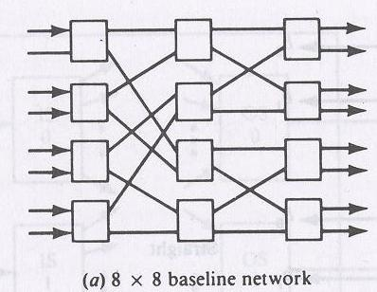

Slide 54
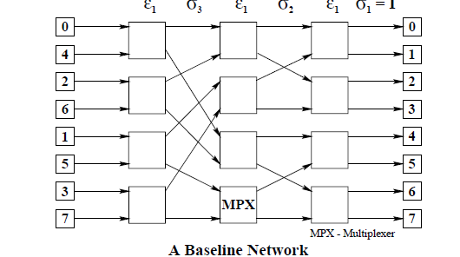

Slide 55
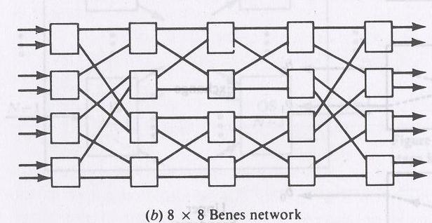

Slide 56
Mesh-connected Illiac n/w
Single stage recirculating n/w is implemented in Illiac-IV array processor with N=64 PEs.
Each PE_{i} is allowed to send data to any one of PE _{i+1}, PE_{i-1}, PE_{i+r}, and PE_{i-r} where r = √N in one circulation step through the n/w.

Slide 57
Illiac n/w is characterized by the following 4 routing functions:
R₊₁(i) = (i+1)mod N
R₋₁(i) = (i-1)mod N
R_{+r}(i) = (i+r)mod N
R_{-r}(i) = (i-r)mod N
Where 0<=i<=N-1. N is commonly a perfect square.

Slide 58
The o/ps of ISi are connected to the i/ps of OSj for j=i+1, i-1, i+r, i-r. On the other hand, OSj gets i/ps from ISi for i=j-1, j+1, j-r and j+r.
Each PEi is directly connected to its 4 nearest neighbours in the mesh n/w.

Slide 59
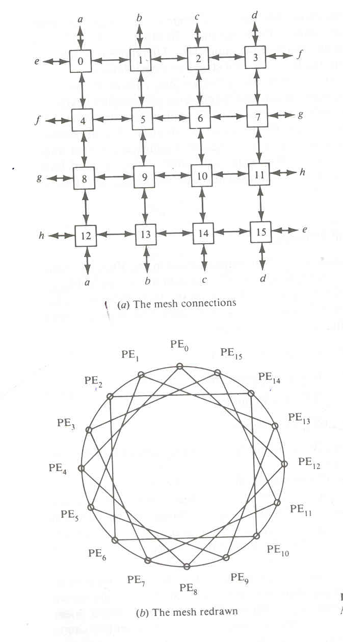

Slide 60
